Slide 1
CHAPTER 4 Optimal Predictive Control 1 Introduction
Anthony Rossiter

Slide 2
Background
The first three chapters have focussed on algorithms such as GPC (or DMC).
These algorithms use open-loop prediction, finite horizons and also, the degrees of freedom are just the first nu control moves.
GPC assumes the predicted control trajectory is constant after nu steps.
HOWEVER, as was made clear in chapter 3, the assumptions on finite horizons can lead to ill-posed optimisations unless those horizons are large, which in turn is computationally demanding.

Slide 3
This chapter
Main aim is to build on the understanding of what constitutes a well-posed optimisation developed in chapter 3.
Using these insights, the aim is to propose an MPC algorithm which will always give a well-posed and meaningful optimisation, irrespective of horizon choices.
This means one can have more confidence in the corresponding control law, and indeed expect better behaviour.
Viewers are reminded that we still exclude discussion of both constraints and feed forward which are left to a later chapter so as not to confuse underlying concepts.

Slide 4
Well-posed optimisation
The class of predictions within the optimisation must include solutions close to both:
the desired closed-loop behaviour.
the closed-loop behaviour that results from repeated use of the optimisation.
In general, the actual closed-loop behaviour is linked to the closed-loop poles which are not on the origin.
This means the typical trajectories converge to the steady-state asymptotically and not in a fixed finite horizon.
HENCE: With finite horizons, one can never include the actual (or desired) closed-loop behaviour.

Slide 5
Typical input predictions vs ideal closed-loop response
Even with a large nu, the predictions cannot get close to a typical closed-loop trajectory.

Slide 6
Summary
In order to match the ‘desired’ closed-loop behaviour, the class of predictions within the optimisation must include input predictions which converge to the steady-state asymptotically rather than in a finite number of steps.
The basic set up of GPC cannot do this, except asymptotically as ny, nu➔∞.
We need a new paradigm for predictive control, deploying a different type of prediction.

Slide 7
Fundamental questions
How do we ensure the predictions used within the optimisation include the ‘desired’ behaviour?
How do we ensure the predictions converge asymptotically rather than in a finite horizon?
To save time, rather than considering several alternatives, this chapter will go straight to what is now a well accepted proposal in the literature.

Slide 8
Key assumption
It is assumed that for the unconstrained case, by one way or another, one can determine the global optimum closed-loop trajectory when the system is linear.
Global optimum will be defined relative to a performance index with infinite horizons
Clearly this is arbitrary to some extent, but one needs a measure of some form before one can determine good and bad.

Slide 9
Definition of global optimum
Optimum is defined as the control trajectory which minimises the following performance index.
Viewers will note that this assumes a fixed set point in the future in order for u_{ss} to be well defined.
The performance index uses infinite horizons for both the future inputs and the future outputs so nothing is omitted and one has full flexibility.

Slide 10
Conclusions
The key weakness of GPC is the use of finite horizons.
In order to ensure a well-posed optimisation, one must include in the class of predictions, those which converge asymptotically.
This class must also include the global optimum.
One could consider that the global optimum is, to some extent, arbitrary, nevertheless one needs to determine what definition will be used for this.

Slide 11



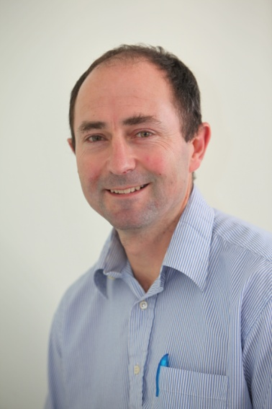
Anthony Rossiter
Department of Automatic Control and Systems Engineering
University of Sheffield
www.shef.ac.uk/acse
© 2014 University of Sheffield
This work is licensed under the Creative Commons Attribution 2.0 UK: England & Wales Licence. To view a copy of this licence, visit http://creativecommons.org/licenses/by/2.0/uk/ or send a letter to: Creative Commons, 171 Second Street, Suite 300, San Francisco, California 94105, USA.
It should be noted that some of the materials contained within this resource are subject to third party rights and any copyright notices must remain with these materials in the event of reuse or repurposing.
If there are third party images within the resource please do not remove or alter any of the copyright notices or website details shown below the image.
(Please list details of the third party rights contained within this work.
If you include your institutions logo on the cover please include reference to the fact that it is a trade mark and all copyright in that image is reserved.)

